Slide 1
Introduction to System Analysis and Design
BE Computer Engineering
KU, Year III/II 2021

Slide 2
Part I
Fundamental Ideas of System Analysis and Design
November 17, 2021.

Slide 3
System
A System is a set of detailed methods, procedures and routines established or formulation to carry out specific activity, perform duty or solve a problem.

Slide 4
What is an Information System
An Information System is a collection of interrelated components that collect, process and store, and provide as output the information needed to complete a business task.

Slide 5
Examples of Information Systems
Course Registration System
Online Food Delivery System
Online Banking System
What else ?

Slide 6
Developing an Efficient IS
Programming is fun, but developing quality information system/software is hard.
In between the nice ideas, the requirements or the "vision," and a working software product, there is much more than programming.

Slide 7
Analysis and Design
“owning a hammer alone doesn't make one an architect”
It requires through System Analysis and Design
System Analysis and Design creates blueprint for Software Engineering …

Slide 8
Analysis and Design ??
Analysis emphasizes an investigation of the problem and requirements, rather than a solution.
For example, if a new computerized library information system is desired, how will it be used?
Design emphasizes a conceptual solution that fulfills the requirements, rather than its implementation.
For example, a description of a database schema and software objects. Ultimately, designs can be implemented.

Slide 9
System Analysis Vs. System Design
Do the Right Thing (Analysis), and Do the Thing Right (Design).
System Analysis is about Investigation of the problem and requirement rather than solution.
System Design is a conceptual solution that fulfills the requirements, rather than implementation.
Analysis and Design is not about programming. It’s creating artifacts that support programming.

Slide 10
System Analyst
A business professional who uses analysis and design techniques to solve business problems using information technology.

Slide 11
The Roles of a System Analyst
Business knowledge.
Business problem solver.
Help translate business requirements into IT projects.

Slide 12
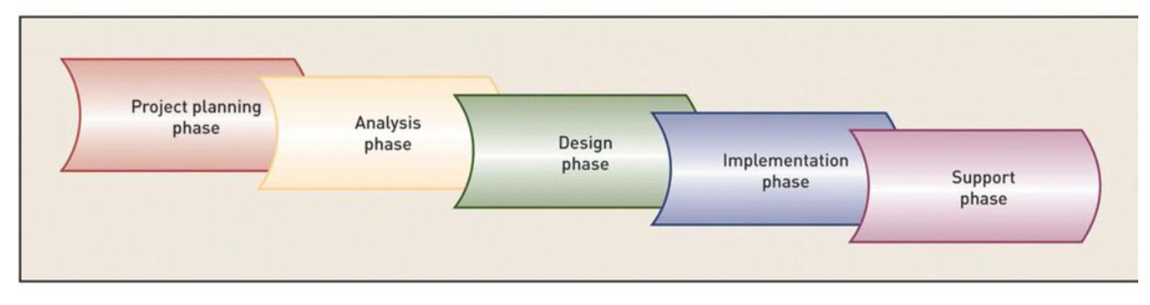
System Development Life Cycle(SDLC)

Slide 13
System Development Life Cycle
Project planning – initiate, ensure feasibility, plan schedule, obtain approval for project
Analysis – understand business needs and processing requirements
Design – define solution system based on requirements and analysis decisions
Implementation – construct, test, train users, and install new system
Support – keep system running and improve it

Slide 14
SDLC
Each of the phases in SDLC include a set of steps, which rely on techniques that produce specific deliverables that provide understanding about the project.
The system evolves through gradual refinement

Slide 15
Planning
This phase is the fundamental process of understanding why an information system should be built.
The Planning phase will also determine how the project team will go about building the information system.

Slide 16
Planning
The Planning phase is composed of two planning steps:
During project initiation, the system’s business value to the organization is identified (How will it lower costs or increase revenues?) as well as the feasibility of the project from different point of views
During project management, the project manager creates a work plan, staffs the project, and puts techniques in place to help the project team control and direct the project through the entire SDLC.

Slide 17
Analysis
The analysis phase answers the questions of who will use the system, what the system will do, and where and when it will be used.
During this phase the project team investigates any current system(s), identifies improvement opportunities, and develops a concept for the new system.

Slide 18
Analysis
This phase has three analysis steps.
Analysis strategy: This is developed to guide the projects team’s efforts. This includes an analysis of the current system.
Requirements gathering: The analysis of this information leads to the development of a concept for a new system. This concept is used to build a set of analysis models.
System proposal: The proposal is presented to the project sponsor and other key individuals who decide whether the project should continue to move forward.

Slide 19
Analysis
The system proposal is the initial deliverable that describes what business requirements the new system should meet.
The deliverable from this phase is both an analysis and a high-level initial design for the new system.

Slide 20
Design
In this phases it is decided how the system will operate, in terms of the hardware, software, and network infrastructure; the user interface, forms, and reports that will be used; and the specific programs, databases, and files that will be needed.

Slide 21
Design
Design Strategy: This clarifies whether the system will be developed by the company or outside the company.
Architecture Design: This describes the hardware, software, and network infrastructure that will be used.
Database and File Specifications: These documents define what and where the data will be stored.
Program Design: Defines what programs need to be written and what they will do.
UI Design

Slide 22
Implementation
During this phase, the system is either developed or purchased (in the case of packaged software).
This phase is usually the longest and most expensive part of the process.

Slide 23
Implementation
This phase has three parts:
System Construction: The system is built and tested to make sure it performs as designed.
Installation: Prepare to support the installed system.
Support Plan: Includes a post- implementation review.

Slide 24
Selecting an Appropriate Methodology
Selecting a methodology is not simple, as no one methodology is always best.
Many organizations have their own standards.

Slide 25
Criteria for selecting a Methodology
Basically there are two approaches to system development
Traditional (Structured) approach
Also called structured system development
Structured analysis and design technique (SADT)
Includes information engineering (IE)
Object-oriented approach
Also called OOA, OOD, and OOP
Views information system as collection of interacting objects that work together to accomplish tasks

Slide 26
UML
UML (Unified Modeling Language) is a graphical language that is suitable to express software or system requirements, architecture, and design.
UML used for both database and software modeling
UML modeling also supports multiple views of the same system.

Slide 27
Category I of the System Development Methodology:
Structured Design
Structured design methodologies adopt a formal step-by-step approach to the SDLC that moves logically from one phase to the next.
This design methodology introduces the use of formal modeling or diagramming techniques to describe business processes (process models) and data (data models).

Slide 28
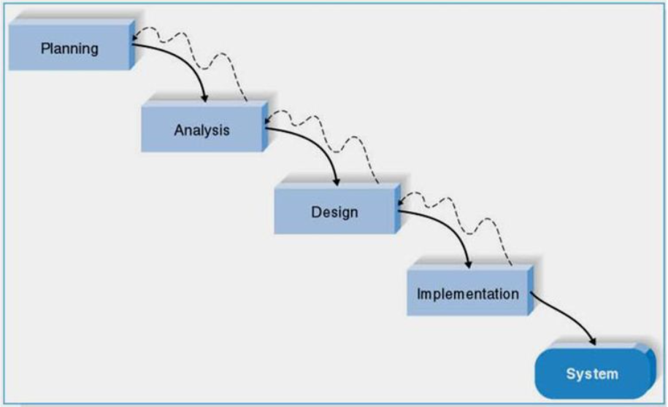
Waterfall Development
With waterfall development- based methodologies, the analysts and users proceed sequentially from one phase to the next.

Slide 29
Advantage and Disadvantages of Waterfall Development
Key Advantages:
-The system requirements are identified long before programming begins.
-Changes to the requirements are minimized as the project proceeds.
Key Disadvantages:
-The design must be completely specified before programming begins.
-A long time elapses between the completion of the system proposal in the analysis phase and the delivery of the system.

Slide 30
Rapid Application Development (RAD)
RAD-based methodologies adjust the SDLC phases to get some part of system developed quickly and into the hands of the users.
Most RAD-based methodologies recommend that analysts use special techniques and computer tools to speed up the analysis, design, and implementation phases, such as CASE (computer-aided software engineering) tools.

Slide 31
Rapid Application Development
Prototyping, CASE, and JAD are key tools that support rapid application development (RAD)
The fundamental principle of any RAD methodology is to delay producing detailed system design documents until after user requirements are clear
RAD involves gaining user acceptance of the interface and developing key system capabilities as quickly as possible

Slide 32
RAD: Phased Development
This methodology breaks the overall system into a series of versions that are developed sequentially.
The team categorizes the requirements into a series of versions, then the most important and fundamental requirements are bundled into the first version of the system.
The analysis phase then leads into design and implementation; however, only with set of requirements identified for version 1.
As each version is completed, the team begins work on a new version.

Slide 33
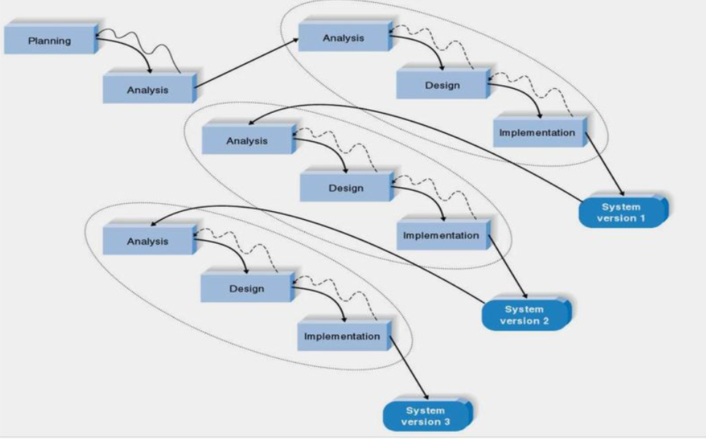
RAD: Phased Development Methodology

Slide 34
Disadvantage of RAD: Phased Development
One possible problem with RAD- based methodologies is managing user expectations.

Slide 35
RAD: Prototyping
Prototyping-based methodologies perform the analysis, design and implementation phases concurrently.
All three phases are performed repeatedly in a cycle until the system is completed.
A prototype is a smaller version of the system with a minimal amount of features.

Slide 36
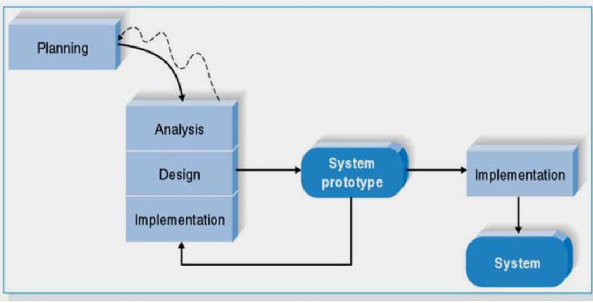
RAD: Prototyping

Slide 37
Adv. and Dis. of Prototyping
Advantage:
Provides a system for the users to interact with, even if it is not initially ready for use. The user can give feedback.
Disadvantages:
Manage user expectations.
Forget some important points since we are prototyping (opposite of careful design)

Slide 38
Agile Development
This category focuses on streamlining the SDLC by eliminating much of the modeling and documentation overhead and the time spent on those tasks.
Projects emphasize simple, iterative application development.

Slide 39
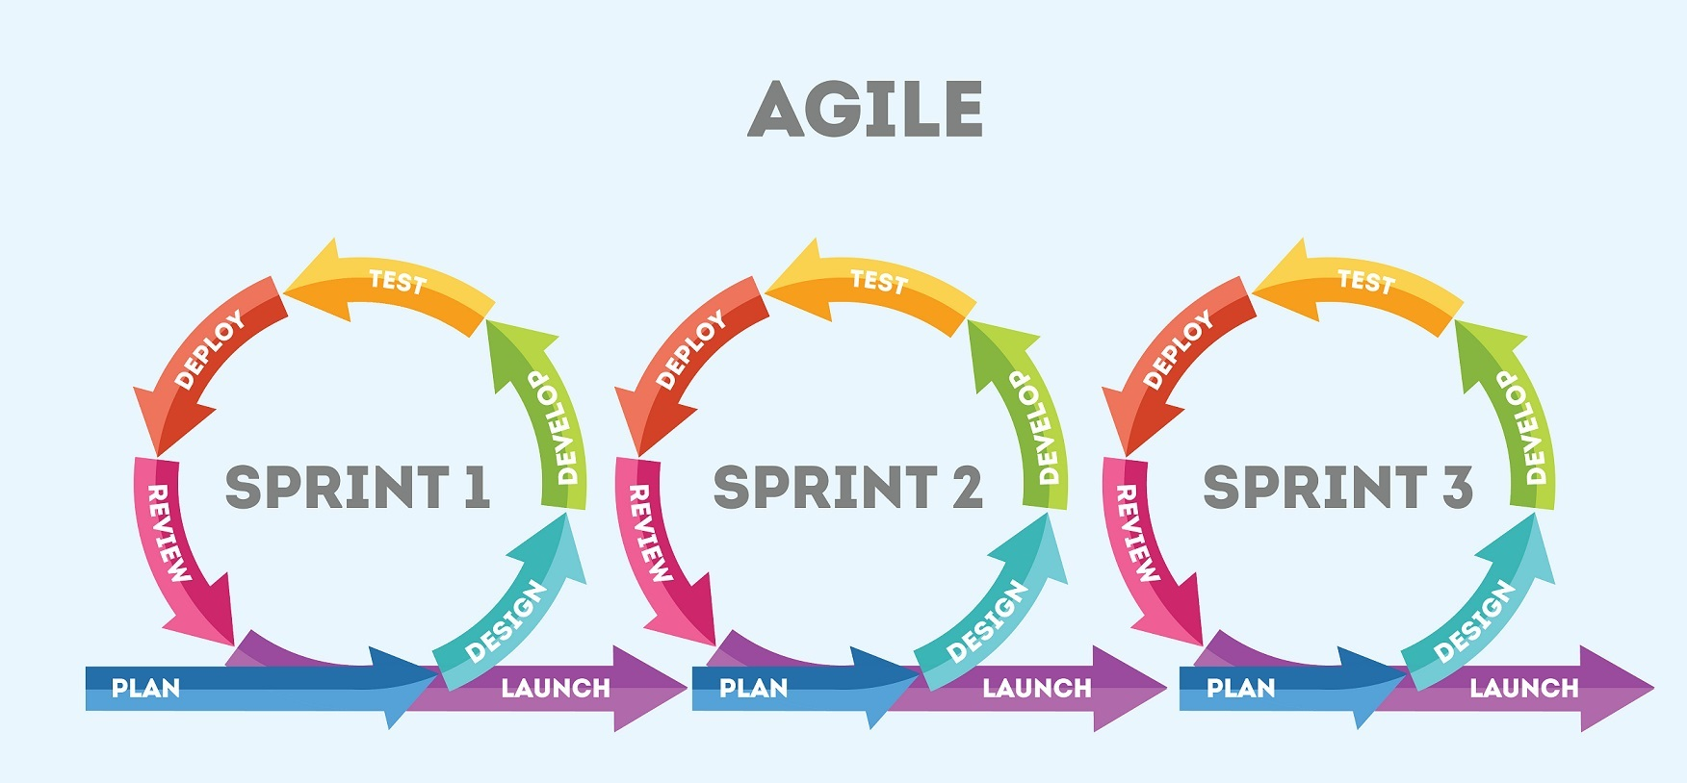
Agile Development

Slide 40
Agile Methodologies
Extreme Programming, Adaptive S/W Development, Scrum
These Agile Methodologies share three key principles:
Adaptive methodologies rather than predictive
People instead of roles
Self-adaptive development process
Adopting an adaptive rather than predictive methodology refers to the observation that engineering based methodologies work best when the process and product are predictive.

Slide 41
Extreme Programming (XP)
Extreme Programming (XP) was founded on four core values:
Communication
Simplicity
Feedback
Courage
Key principles of XP include:
Continuous testing
Simple coding
Close interaction with the end users to build systems very quickly

Slide 42
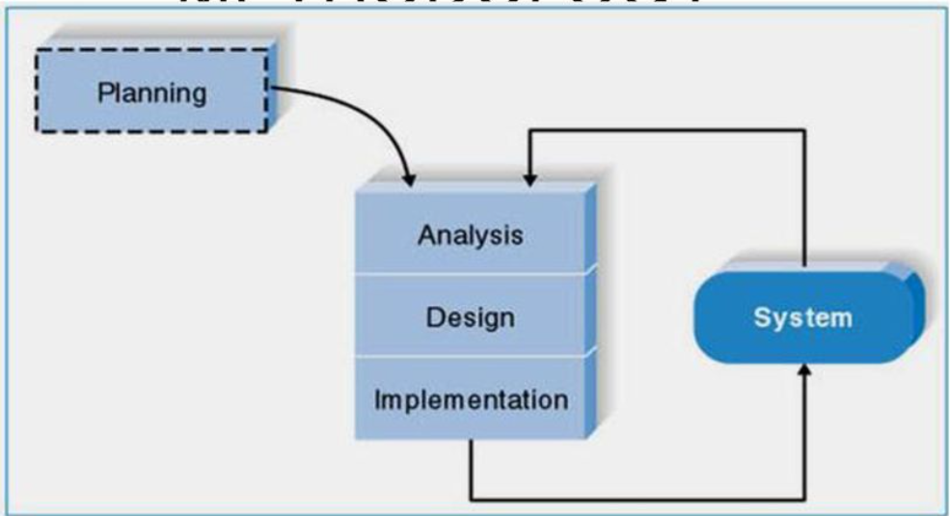
XP

Slide 43
Object Oriented Approach
Completely different approach to information systems
Views information system as collection of interacting objects that work together to accomplish tasks
Objects – things in computer system that can respond to messages
Conceptually, no processes, programs, data entities, or files are defined – just objects
OO languages: Java, C++, C# .NET, VB .NET

Slide 44
Part II
Chapter 1. Introduction to System Analysis and Design
1.1. Introduction
1.2. Development Process
a. Emergent System Properties
b. System Engineering
1.3. Management Process
1.4. Supporting Processes
1.5. System Structure
1.6. Types of Information Systems
a. Transaction Processing System
b. Management Information System
c. Decision Support

Slide 45
What is Information Systems Analysis and Design?
A method used to create and maintain systems that perform basic business functions
Main goal - to improve employee efficiency by applying software solutions to key business tasks
A structured approach to ensure success
Systems Analysts perform SAD based upon:
Understanding of organization’s objectives, structure and processes
Knowledge of how to exploit information technology for advantage

Slide 46
Systems Analysis and Design: Core Concepts
Major goal: to improve organizational systems by developing or acquiring application software and training employees in its use
Application software (or a System): Designed to support a specific organizational function or process
It’s goal is to turn data into information
In addition to application software, the information system includes:
Hardware and system software
Documentation and training materials
Job roles associated with the system
Controls to prevent theft or fraud
The people who use the software to perform their jobs

Slide 47
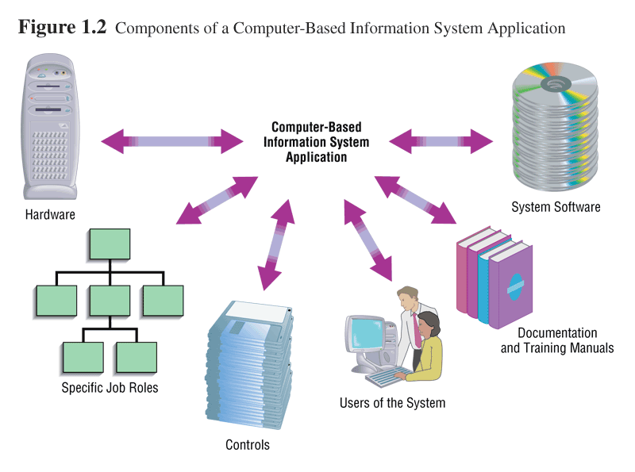
Systems Analysis and Design: Core Concepts

Slide 48
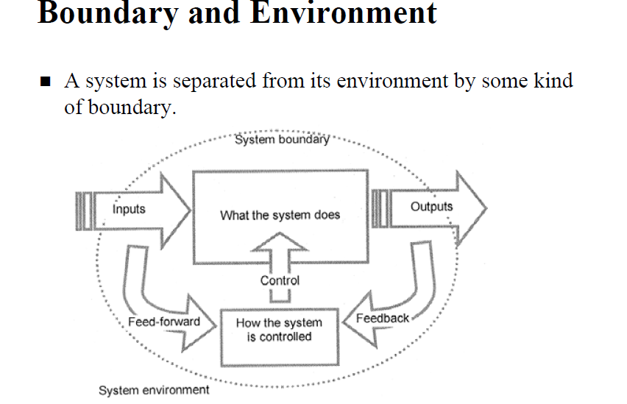
System
A system is an interrelated set of business procedures used within one business unit working together for a purpose
A system exists within an environment
A boundary separates a system from its environment

Slide 49
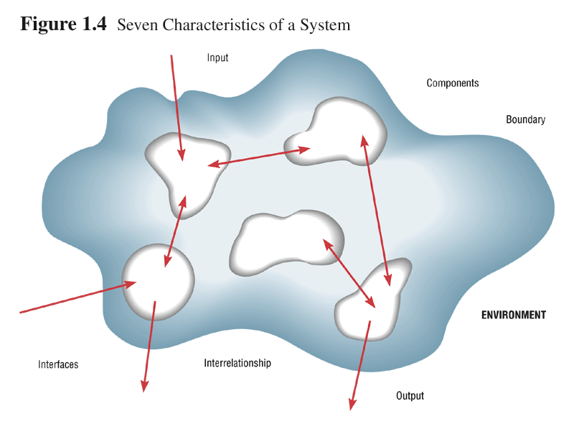
Characteristics of a System
Purpose (Subsystem)
Environment (everything outside the system’s boundary that influences the system)
Boundary
Interrelated Components
Interrelationships
Constraints
Interfaces
Input (from its environment)
Output (to its environment)

Slide 50
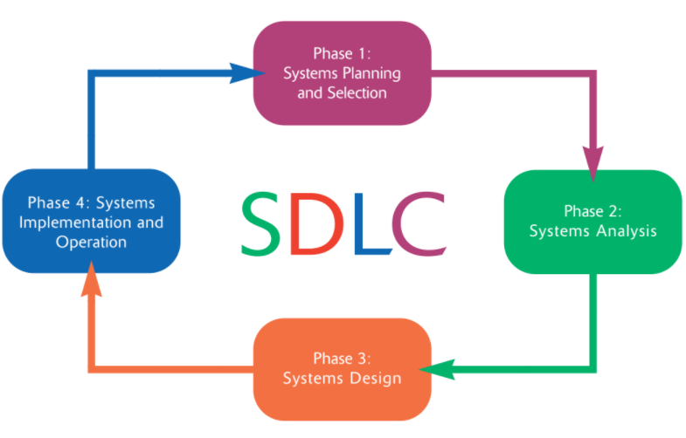
System Development Methodology e.g. SDLC

Slide 51
Developing Information System and SDLC
Systems Development Methodology
A standard process followed in an organization to conduct all the steps necessary to build a system systematically
It includes the following steps:
Plan
Analyze
Design
Implement and Maintain information systems.

Slide 52
Phases of the SDLC
1.Systems Planning and Selection
Two Main Activities
Identify the need of a system
Investigation and determination of scope
The team of systems analysts then produces a specific plan for the proposed project for the team to follow. This plan specifies the time and resources needed for its execution

Slide 53
Phases of the SDLC ...
2. Systems Analysis
Study of current procedures and information systems
Determine requirements
Generate alternative designs match the requirements
Compare alternatives to see which best meets the requirements within the cost, labor, and technical levels the organization is willing to commit to the development process
Recommend best alternative

Slide 54
Phases of the SDLC ... ...
3. System Design
Convert the description of the recommended alternative solution into logical and then physical system specification
Logical Design
Concentrates on business aspects of the system, that is, how the system will impact the functional units within the organization
Physical Design
Technical specifications: programming languages, database systems and file structures, hardware platform, operating system and network environment

Slide 55
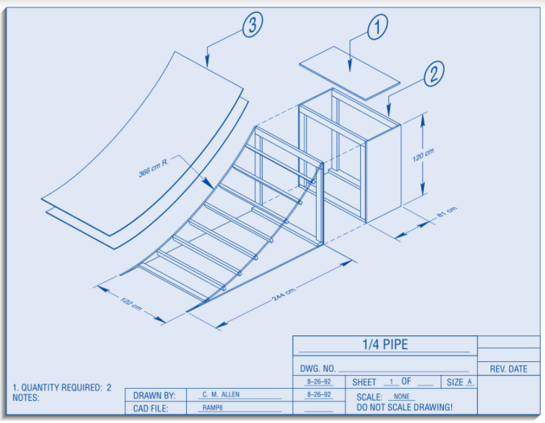
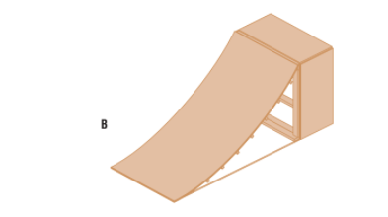
Logical design Vs Physical Design

Slide 56
Phases of the SDLC ...
4. System Implementation , Operation and Maintenance :
Turn system specifications into a working system that is tested and then put into use
Implementation
Coding
Testing
Installation: the new system becomes a part of the daily activities of the organization
User Training
Documentation
Maintenance (fix errors, make changes)

Slide 57
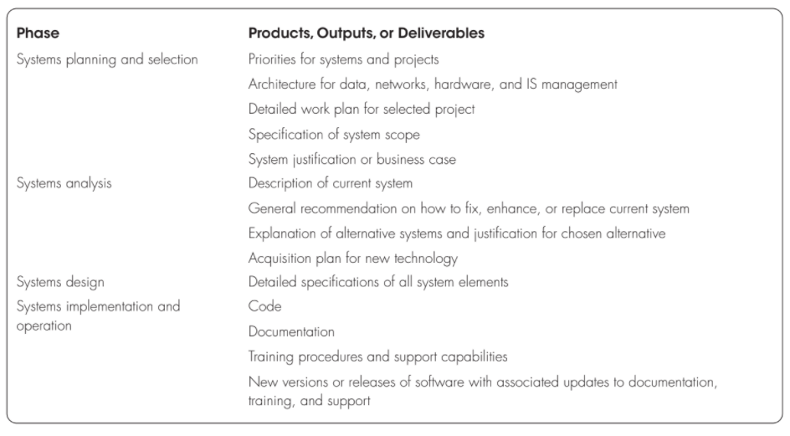
Product Outputs and Deliverables from SDLC ...

Slide 58
Roles of System Analyst in the SDLC ...
Study problems and needs of an organization
Determine best approach to improving organization through use of:
People
Methods
Information technology
Help system users and managers define their requirements for new or enhanced information systems

Slide 59
Your Skills As System Analyst
Analytical skills: to understand the organization and its functions, to identify opportunities and problems, and to analyze and solve problems.
Systems thinking: ability to see organizations and information systems as systems. Provides a framework from which to see the important relationships among information systems, the organizations they exist in, and the environment in which the organizations themselves exist.
Technical skills: help you understand the potential and the limitations of information technology.
Able to work with programming language, various operating systems and computer hardware platforms

Slide 60
Your Skills As System Analyst
3. Management skills: help you manage projects, resources, risk, and change
4. Interpersonal skills: help you work with end users as well as with other analysts and programmers
Effective written and oral communication
Leading meetings
Interviewing end users and listening

Slide 61
Computer-Aided Software Engineering (CASE) Tools
Automated software tools used by systems analysts to develop information systems
Project management tools (Openproj, MS Project)
Diagramming tools (Dia, Visio)
Computer display and report generators (VB)
Analysis tools (Visual Analyst)
Documentation generators
Code generators
Integration of tools via a repository

Slide 62
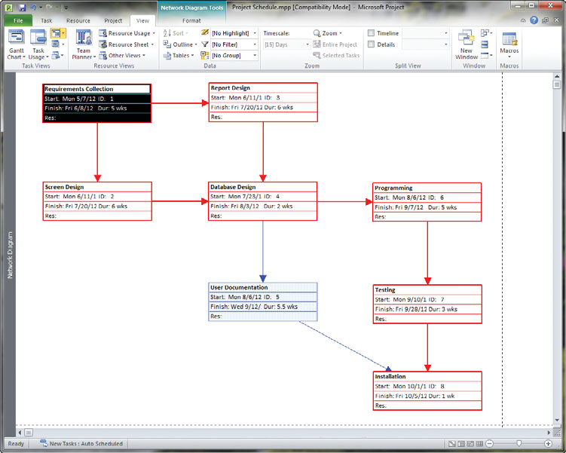
An Example : MS Project

Slide 63
CASE Tools
The General CASE tools include:
Diagramming tools that enable system process, data, and control structures to be represented graphically.
Computer display and report generators that help prototype how systems “look and feel” to users. Display (or form) and report generators also make it easier for the systems analyst to identify data requirements and relationships.
Analysis tools that automatically check for incomplete, inconsistent, or incorrect specifications in diagrams, forms, and reports.
A central repository that enables the integrated storage of specifications, diagrams, reports, and project management information.
Documentation generators that help produce both technical and user documentation in standard formats.
Code generators that enable the automatic generation of program and database definition code directly from the design documents, diagrams, forms, and reports.

Slide 64
Alternative Approaches to Development
Joint Application Design (JAD)
Users, Managers and Analysts work together for several days
System requirements are reviewed
Structured meetings
By gathering the people directly affected by an IS in one room at the same time to work together to agree on system requirements and design details, time and organizational resources are better managed

Slide 65
Participatory Design
Developed in northern Europe, participatory design (PD) represents a viable alternative approach to the SDLC.
PD emphasizes the role of the user much more than do traditional North American techniques such as structured analysis and structured design.
In some cases, PD may involve the entire user community in the development process.
Each user has an equal voice in determining system reuirements and in approving system design.
In other cases, an elected group of users controls the process. These users represent the larger community, much as a legislature represents the needs and wants of the electorate.

Slide 66
Emergent Properties
Properties of the system as a whole rather than properties that can be derived from the properties of components of a system
Emergent properties are a consequence of the relationships between system components
They can therefore only be assessed and measured once the components have been integrated into a system

Slide 67
Types of emergent properties
Functional properties
These appear when all the parts of a system work together to achieve some objective. For example, a bicycle has the functional property of being a transportation device once it has been assembled from its components
Non-functional emergent properties
Examples are reliability, performance, safety, and security. These relate to the behaviour of the system in its operational environment. They are often critical for computer-based systems as failure to achieve some minimal defined level in these properties may make the system unusable.

Slide 68
Types of information system
Executive
Executive
Information
System
(Wisdom)
Senior
Decision
Mangers
Support
System
(Knowledge)
Mid
dle
Management
Managers
Information System
(
Information
)
Workers
Transaction Processing
System
(Data)
Types of Information System

Slide 69
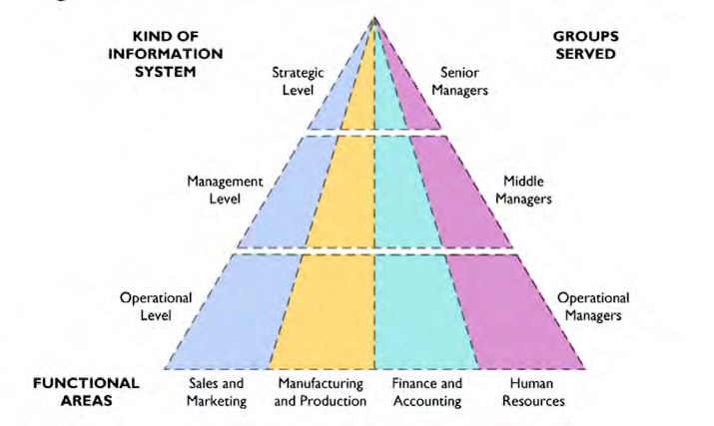
Types of Information Systems

Slide 70
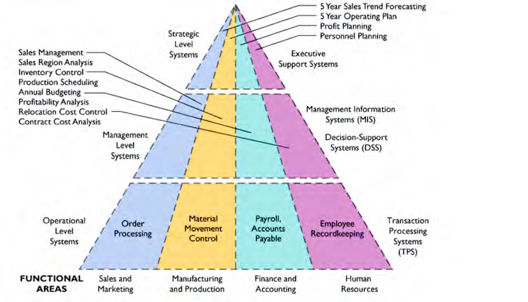
Types of ISs

Slide 71
Transaction processing system
These are the computerized systems that perform and records the daily routine transactions necessary to conduct business.
These systems serve the operational level of the organization. Some examples include sales order entry, hotel reservation systems, payroll, employee record keeping, and shipping.
Transaction processing systems are boundary-spanning systems that permit the organization to interact with external environments.
Transaction processing systems are central to a business. TPS failure for a few hours can cause a firm’s demise and perhaps other firms linked to it.
Managers need TPS to monitor the status of internal operations and the firm’s relations with external environment. TPS are also major producers of information for the other types of systems.

Slide 72
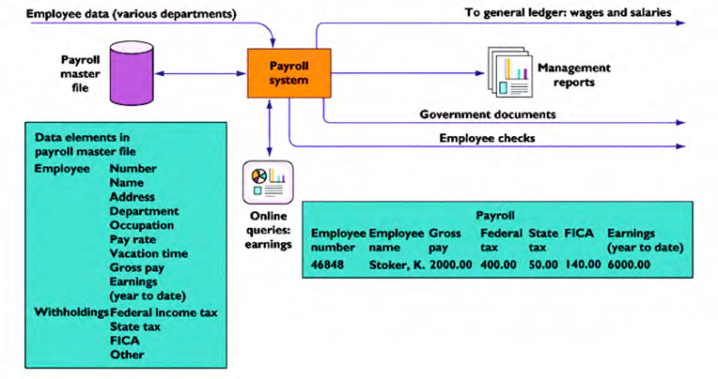
Example: TPS

Slide 73
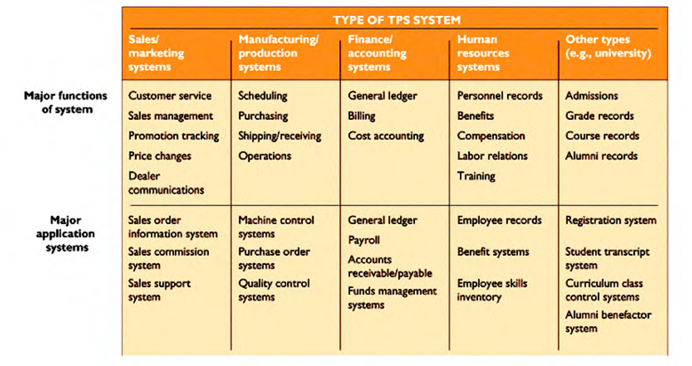
Applications of TPS

Slide 74
MIS
These are the information systems at the management level of an organization and serve management-level functions like planning, controlling, and decision-making.
These systems provide reports that are usually generated on a predetermined schedule and appear in prearranged format.
Typically, these systems use internal data provided by the transaction processing systems.
These systems are used for structured decision-making and in some cases for semi-structured decision making as well.
Salary analysis and sales reporting are the examples in which MIS can be used.

Slide 75
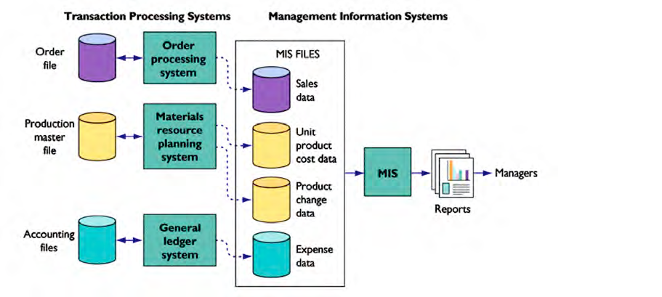
TPS and MIS

Slide 76
Executive information system
These systems are also called executive support systems (ESSs) and serve the strategic level of the organization.
These systems are designed to address unstructured decision making through advanced graphics and communication.
These systems incorporate data about external events such as new tax laws or competitors, but they also draw summarized information from internal MIS and DSS.
These systems are not designed to solve a specific problem but they provide a generalized computing and telecommunication capacity that can be applied to a changing array of problems. 5-year operating plan is an example in which EIS can be used.
ESS extend and support the capabilities of executives, permitting them to make sense of their environments.

Slide 77
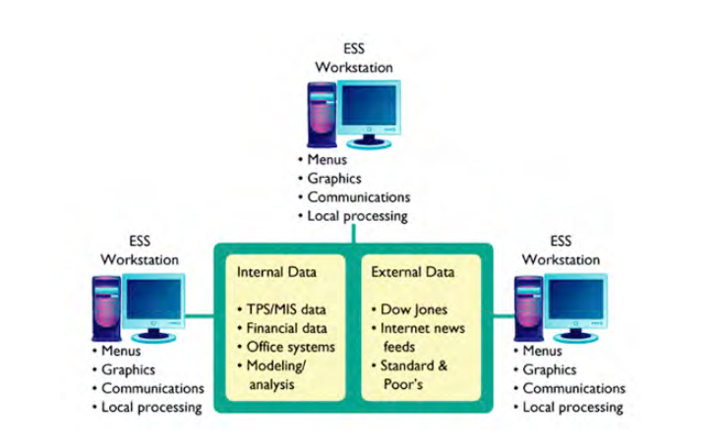
Executive Support System

Slide 78
Expert System
A programmed decision-making information system that captures and reproduces the knowledge and expertise of an expert problem solver or decision maker and then simulates the “thinking” or “actions” of that expert.
Expert systems are implemented with artificial intelligence technology that captures, stores, and provides access to the reasoning of the experts.

Slide 79
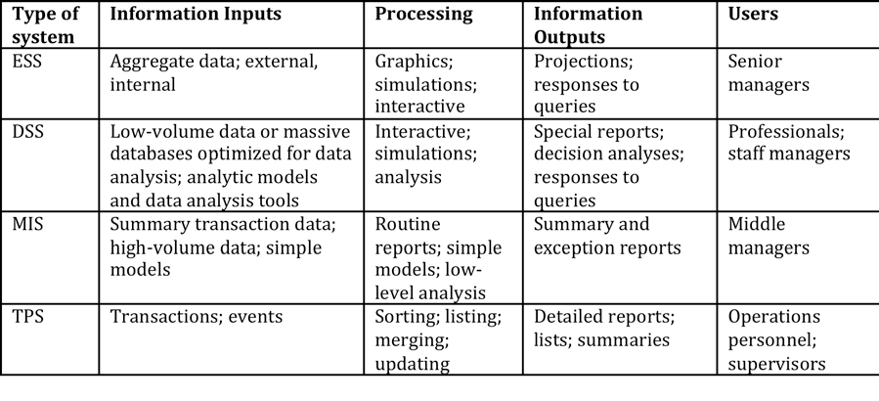
Summary of ISs

Slide 80
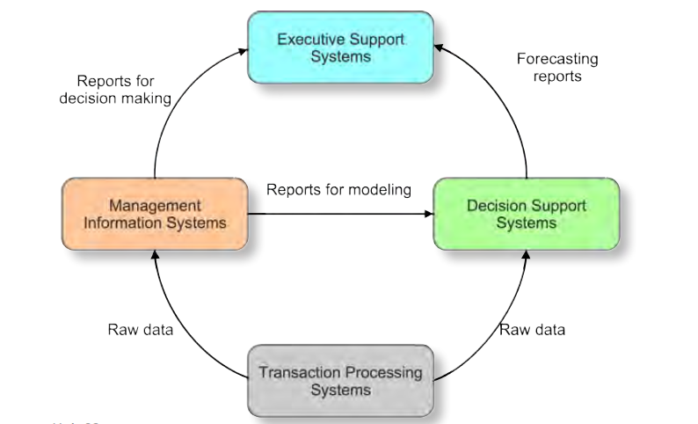
Interconnection among ISs

Slide 81
Thank you !!!

Slide 82
References

